Slide 1

Clinical utility of mechanical echocardiographic dispersion to assess left ventricular function and ischemia or infarction detected by gated 99m-Tc Sestamibi-SPECT
Nilda Espinola-Zavaleta
MD, PhD, FACC, FASE, FESC
@NildaGladys60

Slide 2
Background: Coronary artery disease is the leading cause of morbidity and mortality worldwide. Left ventricular asynchrony could be useful for detection of ischemia or infarction.
Aims: To assess the systolic and diastolic mechanical dispersion (MD) by 3D-ECHO and its correlation with left ventricular ejection fraction (LVEF) and ischemia or infarction by myocardial perfusion study (MPS) gated 99m-Tc Sestamibi-SPECT.

Slide 3
Methods: Cross-sectional study of patients with angina. Systolic and diastolic MD was calculated by the standard deviation of the time to achieve the minimum volume corrected for the R-R interval. Association with LVEF was assessed with Pearson correlation coefficients and linear regression models. ROC curves were used to identified ischemia or infarction and compared MD, E/A, IVRT, E/e’ and TAPSE.

Slide 4
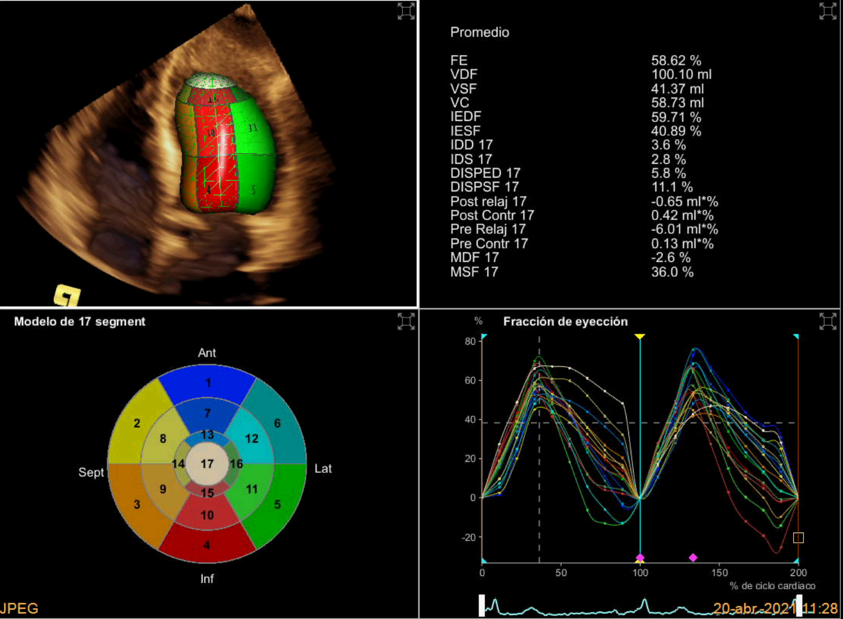

A
B
A- Three-dimensional transthoracic four chamber view showing normal left ventricular ejection fraction (LVEF) and systolic and diastolic mechanical dispersion. B- Gated 99m-Tc Sestamibi-SPECT- Severe hypokinesia of the apex and septal wall is observed, and moderate hypokinesia of the anterior wall in its apical and middle third. The LVEF at rest was of 52% with a drop to 47% during stress, which is a marker of high risk for multivessel disease

Slide 5

A
B
A-Three-dimensional transthoracic four chamber view showing normal left ventricular ejection fraction (LVEF) and systolic and diastolic mechanical dispersion. B-Gated 99m-Tc Sestamibi-SPECT- Polar map of myocardial perfusion scintigraphy with transmural infarction in the territory of the left anterior descending artery. At rest, the TPD is 29% and the extension 32% and with stress it is 31% and 35%, respectively.

Slide 6
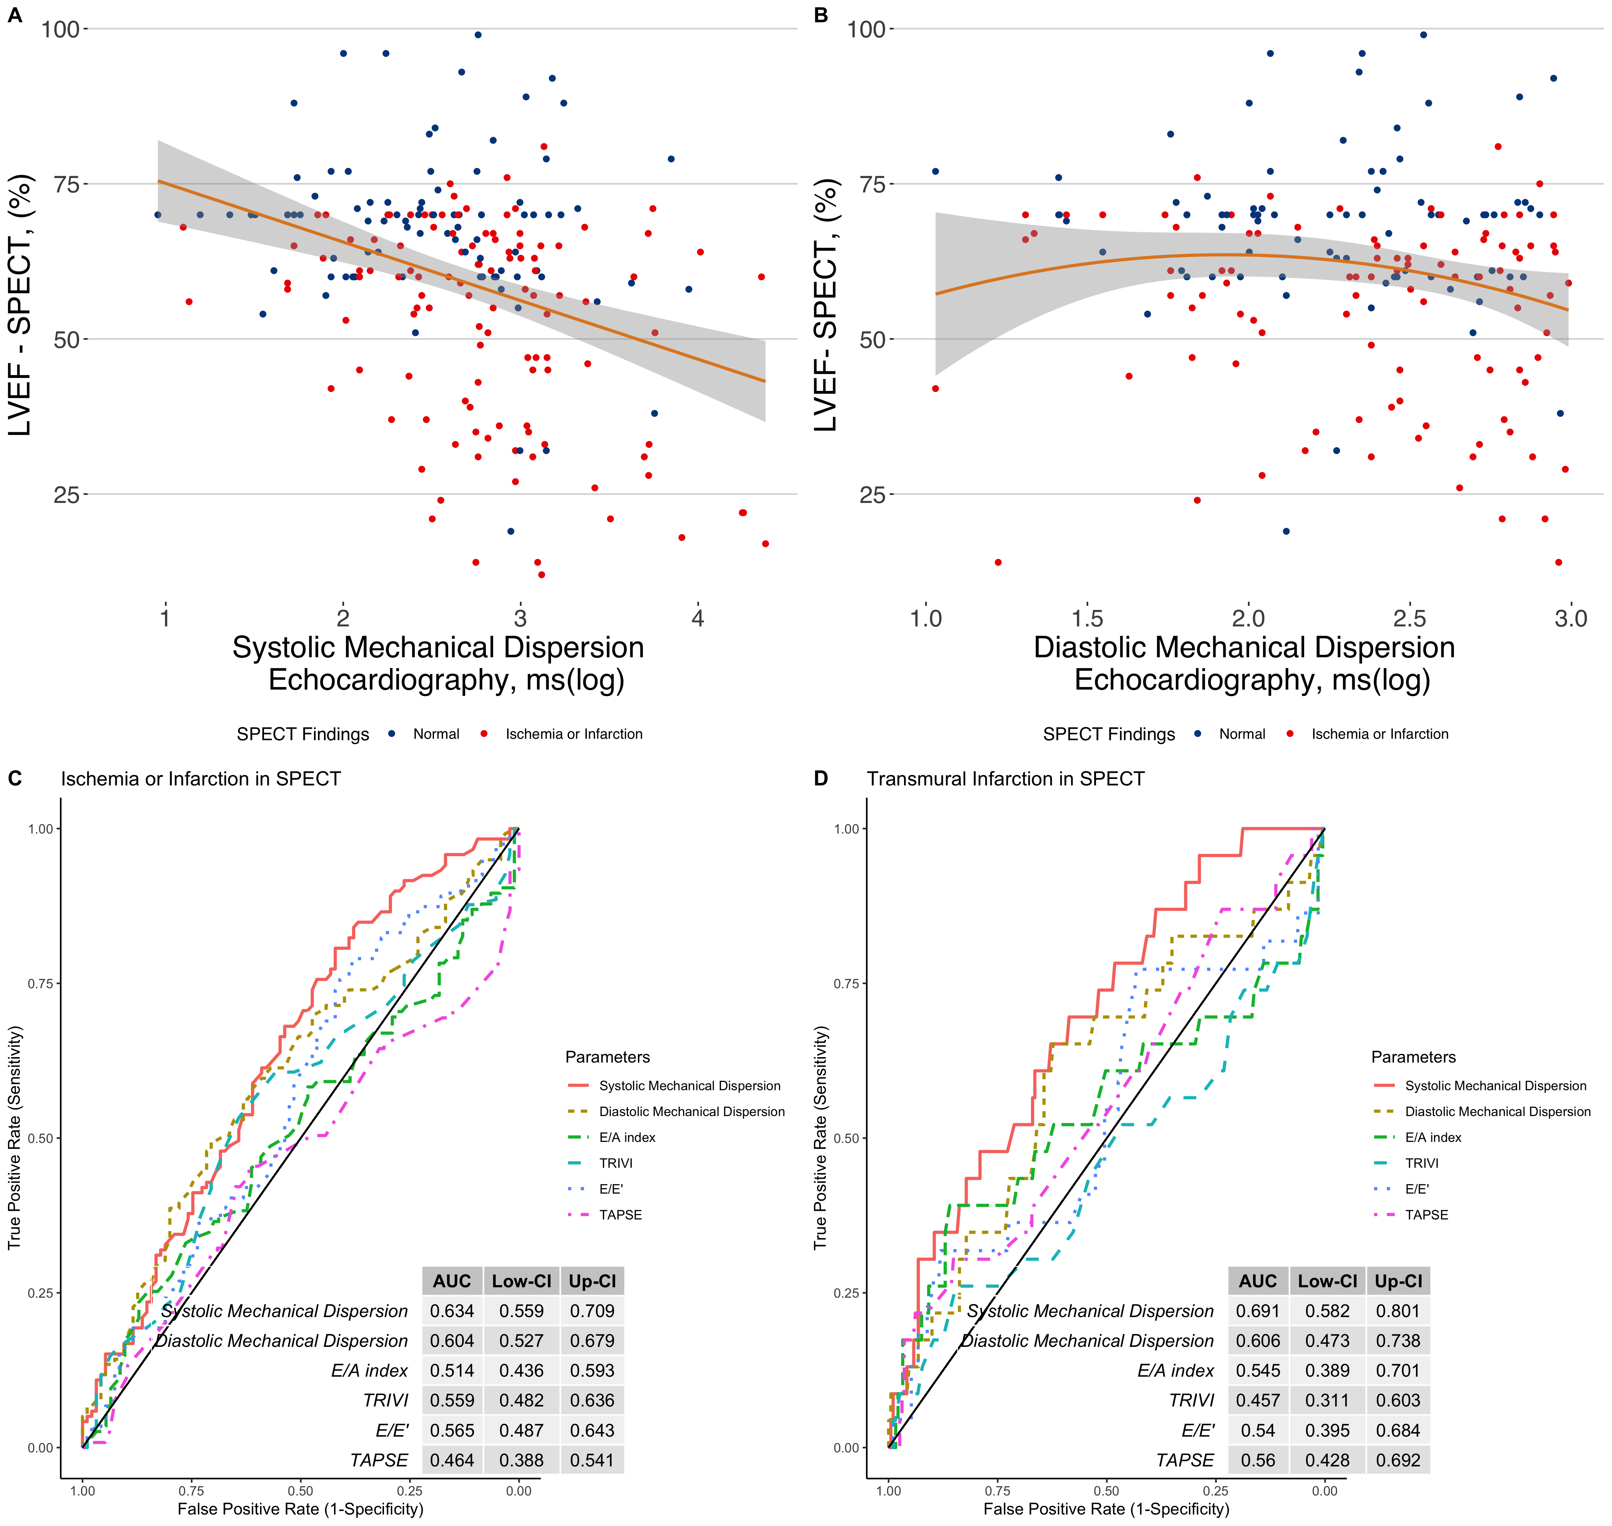
Figure 1: Correlation analysis of systolic (A) and diastolic (B) mechanical dispersion with left ventricular ejection fraction assessed with MPS-SPECT.

Slide 7
Figure 1: ROC curve analysis to assess the AUC for different echocardiographic parameters for ischemia or infarction (C) and transmural infarction (D) with MPS-SPECT.

Slide 8
Conclusion: Systolic and diastolic MD are useful and simple parameters for the assessment of left ventricular function and ischemia or infarction.

